Slide 1


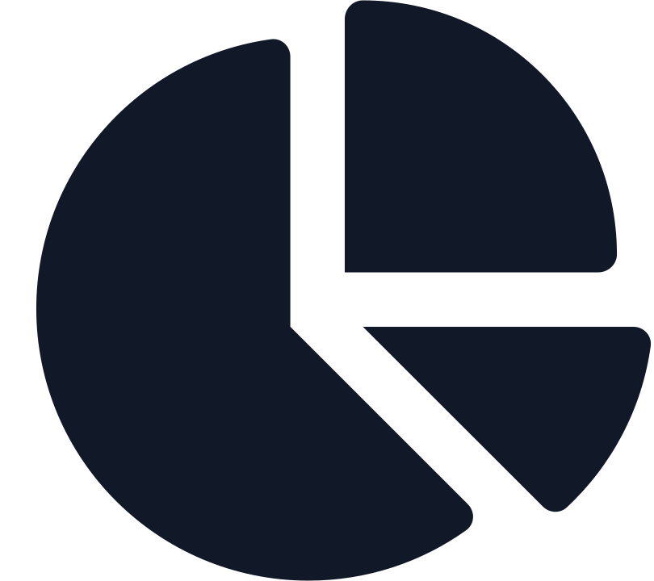



Course Module
03
Principles of
Marketing
Segmentation,
Targeting, and
Buyer Behavior
Fall 2026
A comprehensive analysis of how to identify, select, and understand your most valuable customers.
INSTRUCTOR
Dr. Liz Kheng
Market Segments
Target Strategies
Consumer Psychology
Department of Business Administration

Slide 2










Module 3
Principles of Marketing
Segmentation, Targeting, and Buyer Behavior
Module Overview
Why "Everyone" Is NOT Your Target Market
"If you try to be everything to everyone,
you’ll be nothing to anyone."
Relevance & Results
Strategic Alignment
Resource Optimization
Focus drives relevance. By narrowing your scope, you deepen your impact on the customers who matter most.
Segmentation ensures your product features, messaging, and channel selection are perfectly aligned.
Targeting prevents budget waste by directing limited resources only toward high-potential segments.
02

Slide 3




Module 3
Learning Objectives
Segmentation, Targeting, and Buyer Behavior
Key Outcomes
01
Define Segmentation
What We Will Cover
Define market segmentation and explain its strategic purpose in modern marketing.
The Four Bases
02
Describe the four primary bases of segmentation: Demographic, Geographic, Psychographic, and Behavioral.
By the end of this module, you will be able to apply these five core concepts to build more effective marketing strategies.
Evaluation Criteria
03
Evaluate criteria for effective segments to ensure they are measurable, accessible, substantial, and actionable.
Targeting Strategies
04
Compare and contrast undifferentiated, differentiated, and concentrated targeting strategies.
05
Buyer Behavior
Explain how buyer behavior and decision processes influence targeting and messaging.
03

Slide 4






Module 3
The "Everyone" Trap
Segmentation, Targeting, and Buyer Behavior
Unclear Value Proposition
Product benefits don't resonate strongly with any specific group.
Low Conversion
Generic Messaging
Poor retention and conversion because the fit is never "just right".
"Vanilla" communication leads to low engagement and click-through rates.
Targeting
Everyone
The Strategy of "No Strategy"
Weak Positioning
Wasted Budget
Vulnerable to competitors who serve specific niches better.
Spending across broad channels reaches too many non-buyers.
Result: High Cost of Acquisition, Low Customer Lifetime Value
04

Slide 5




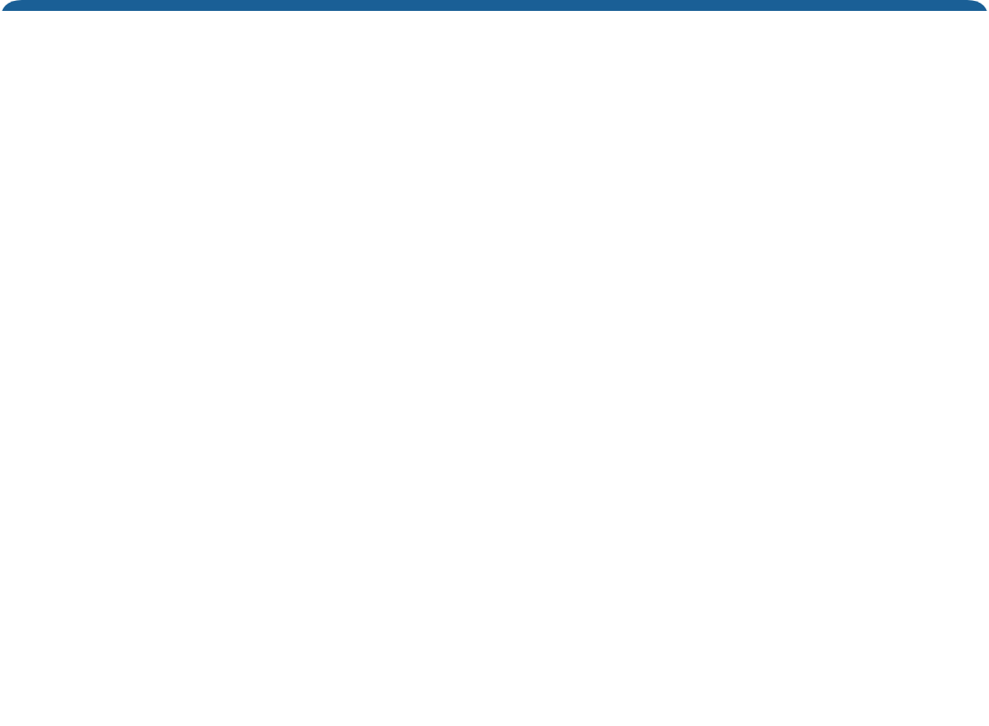
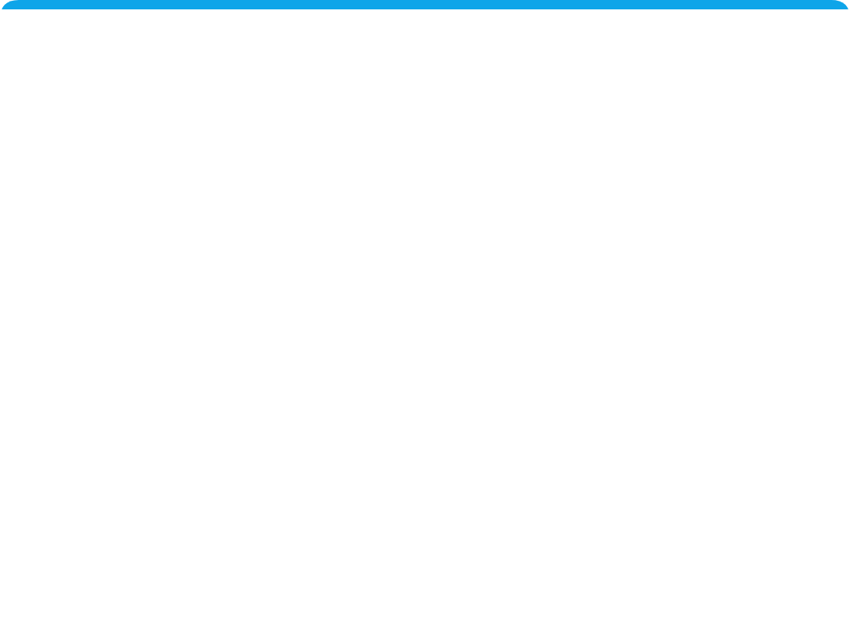








Module 3
Core Concepts
Segmentation, Targeting, and Buyer Behavior
What Is Segmentation?
“
Formal Definition
The process of dividing a broad consumer or business market into based on shared characteristics, needs, or behaviors.
smaller, meaningful groups
Key Strategic Benefits
Better Fit
Efficiency
Personalization
05
Match offerings precisely to specific segment needs rather than forcing a generic solution on everyone.
Maximize ROI by directing marketing spend only toward the most responsive and profitable groups.
Create highly relevant messaging and experiences that resonate personally, driving higher conversion rates.

Slide 6











Module 3
Case Example
Segmentation, Targeting, and Buyer Behavior
Before: Generic Approach
After: Segmented Strategy
"Smoothies for Everyone"
Tailored Experiences
Treating the entire campus as one homogeneous market with a single marketing mix.
Dividing the market into distinct groups and customizing the offer for each.
One-Size Menu
Distinct Segments
Standard menu options regardless of customer goals.
Early Athletes: High protein, post-workout.
Budget Students: Value combos, grab-and-go.
Wellness Seekers: Detox greens, organic.
Broad Promotions
"10% off for students" posted randomly around campus.
Timed Offers
Inconsistent Traffic
Morning protein push vs. afternoon "study boost" promos.
Unpredictable rushes and dead zones.
The Struggle
Business Results
Low Customer Retention
+24%
+15%
Customers felt the brand was "okay" but not for them.
Repeat Visits
Avg Order Value
06

Slide 7







Module 3
Evaluation Criteria
Segmentation, Targeting, and Buyer Behavior
Criteria for Effective Segmentation
To be useful, market segments must rate favorably on these four key attributes.
01
02
03
04
Measurable
Accessible
Substantial
Actionable
Can you quantify the size, purchasing power, and profiles of the segment?
Can the market segment be effectively reached and served with your marketing mix?
Is the segment large or profitable enough to warrant a tailored marketing program?
Can you design effective programs to attract and serve the segment with your resources?
Identifiable traits
Data availability
Media habits known
Profit potential
Resource capability
Distribution channels
Sustainable growth
Competitive advantage
07

Slide 8











Module 3
Core Framework
Segmentation, Targeting, and Buyer Behavior
The Four Segmentation Bases
Marketers typically combine these four methods to identify their best customers.
Demographic
Geographic
Grouping based on observable population characteristics. The most common and easiest to measure.
Grouping based on physical location and related spatial factors. Critical for local businesses.
Age
Gender
Income
Education
Occupation
Region
City Size
Climate
Density
Urban/Rural
Psychographic
Behavioral
Grouping based on psychological traits, values, and lifestyle. explains "why" they buy.
Grouping based on how they act toward, use, or know a product. Often the best predictor of future sales.
Lifestyle
Values
Personality
Interests
Opinions
Usage Rate
Loyalty
Occasions
Benefits
08

Slide 9
















Module 3
Basis 1: Demographic
Segmentation, Targeting, and Buyer Behavior
Demographic Segmentation
Dividing the market into groups based on variables such as age, life-cycle stage, gender, income, occupation, education, religion, ethnicity, and generation.
Why it's popular:
Easy to measure & highly correlated with needs.
Age
Gender
Income
Education
The Budget Commuter
The International Grad
The Working Parent
Value Seeker
Quality Driven
Convenience Focus
Age:
19 (Sophomore)
Age:
24 (MBA Student)
Age:
28 (Night Classes)
Income:
Low (Part-time job)
Income:
High Allowance
Income:
Middle (Full-time)
Living:
Off-campus w/ parents
Living:
Luxury Student Apts
Status:
Married, 1 Child
Priority:
Price & Speed
Priority:
Health & Premium
Priority:
Hours & Efficiency
"I need a quick caffeine boost before my 8am lecture, but I can't spend more than $5."
"I'm looking for organic ingredients and a nice place to study. Price isn't an issue."
"I need a healthy meal replacement I can grab on my way from work to night school."
09

Slide 10














Module 3
Basis 2: Geographic
Segmentation, Targeting, and Buyer Behavior
Dorm Clusters
North Quad
Geographic Segmentation
Grouping consumers based on physical location—countries, regions, cities, or even specific neighborhoods and campus zones.
Geofence Radius
Student Union
Campus Strategies
Traffic Zone
Residential Clustering
Rec Center
Targeting dorms with "Late Night Delivery" offers.
Hyper-Local Geofencing
Push notifications triggered within 0.5 miles of the Student Union.
Traffic Zones
Targeting high foot-traffic areas (Gym/Library) with morning promotions.
Map Legend
Housing
Recreation
Promo Zone
10

Slide 11






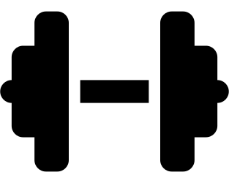








Module 3
Basis 3: Psychographic
Segmentation, Targeting, and Buyer Behavior
Psychographic Segmentation
Understanding the "Why" behind the buy.
Dividing a market based on social class, lifestyle, and personality characteristics. Unlike demographics (who they are), this focuses on what they value and how they live.
Values
Environmental Consciousness
01
Sustainability Advocates
Students who prioritize eco-friendly practices and ethical consumption.
Strategy Eco-packaging & Cause Tie-ins
Lifestyle
Health & Wellness Focus
02
Fitness Enthusiasts
Active individuals focused on nutrition, performance, and routine.
Strategy High-protein options & Early-bird hours
Personality
03
Social Connectors
Social Connection & Belonging
Extroverted students who use food/activity as a means to socialize.
Strategy BOGO deals & Shareable portions
11

Slide 12










Module 3
Basis 4: Behavioral
Segmentation, Targeting, and Buyer Behavior
Behavioral Segmentation Matrix
Tailoring marketing strategies based on Usage Rate and Loyalty.
LOW USAGE
HIGH USAGE
BRAND LOYALTY
Loyal Occasional
True Loyalist
"The Supporter"
"The VIP"
HIGH LOYALTY
They love your brand but don't have a high need frequency.
Your most valuable customers. High frequency and strong preference.
Strategy: Upsell & Remind
Strategy: Reward & Retain
Convenience boosts, occasion reminders, add-ons.
VIP tiers, exclusive access, community building.
Switcher / New
Deal Hunter
"The Prospect"
"The Switcher"
LOW LOYALTY
Rarely buys, no brand preference. Price sensitive or unaware.
Buys the category often, but switches brands based on price/deals.
12
Strategy: Induce Trial
Strategy: Lock-In
First-time coupons, awareness campaigns, samples.
Punch cards, frequency rewards, competitor comparison.
USAGE RATE

Slide 13






Module 3
Targeting Strategies
Segmentation, Targeting, and Buyer Behavior
Targeting Strategies
How broadly or narrowly should you target your market?
Undifferentiated
Differentiated
Concentrated
Mass Marketing
Segmented Marketing
Niche Marketing
Mix A
Mix
Mix B
Mix
Mix C
Ignores segment differences and targets the whole market with one offer. Focuses on common needs.
Targets several market segments and designs separate offers for each.
Goes after a large share of one or a few smaller segments or niches.
Pros: Higher total sales, stronger position within each segment.
Pros: Strong market position, deep knowledge of needs, efficiency.
Pros: Low cost (production, inventory, marketing), economies of scale.
Cons: Increased costs for separate plans, research, and promo.
Cons: Higher risk if segment fails or large competitor enters.
Cons: Low relevance, vulnerable to focused competitors.
Example
Example
Example
Staple commodities (Salt, Sugar), Early Model T Ford.
Toyota (Lexus, Toyota, Scion), P&G Laundry Detergents.
Whole Foods (originally), Left-handed Store, OshKosh B'Gosh.
13

Slide 14













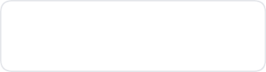



Module 3
Buyer Behavior Equation
Segmentation, Targeting, and Buyer Behavior
Understanding Buyer Behavior
Purchases aren't just transactions; they are the result of complex inputs.
Rational
Emotional
Social
Decision
Logic, functionality, and economic value.
+
Feelings, aspirations, and brand connection.
+
Peer influence, trends, and cultural norms.
=
The final purchase action.
Is the price right?
Do I trust this brand?
What will friends think?
Outcome
Is it convenient?
Does it make me feel good?
Is it popular on campus?
Purchase
Does it solve my problem?
Does it match my identity?
Do I belong to this group?
Smoothie Example
"I'm buying this smoothie because it's affordable (Rational), it makes me feel healthy (Emotional), and my study group goes there (Social)."
14

Slide 15











Module 3
Buyer Decision Process
Segmentation, Targeting, and Buyer Behavior
The Buyer Decision Process
Consumers pass through five stages with every purchase. Marketers must understand and influence each step, not just the sale.
1
2
3
4
5
Problem Recognition
Information Search
Evaluation of Alternatives
Purchase Decision
Post-Purchase Behavior
Perceiving a need or a difference between current state and ideal state.
Seeking value via internal memory or external sources (Google, friends).
Assessing value by comparing attributes against criteria (price vs. quality).
Buying value. Transforming purchase intent into actual action.
Consuming value. Satisfaction, word-of-mouth, and potential loyalty.
Trigger
Research
Action
Reflect
Compare
Marketing Insight: The process starts long before the purchase and continues long after. Marketers must reduce friction at every stage.
15

Slide 16









Module 3
Barriers to Action
Segmentation, Targeting, and Buyer Behavior
Real Barriers to Action
Even if you target the right segment with the right product, invisible friction can stop them from buying.
Low Awareness
Time & Convenience
Stigma / Fear
The target audience simply doesn't know the solution exists.
Scheduling conflicts or location friction prevent usage.
Psychological barriers related to identity or embarrassment.
I didn't know we had a tutoring center.
It's only open when I'm in class.
I don't want to look dumb asking for help.
Complexity
Perceived Cost
The process to sign up or purchase is too confusing.
Assuming it's expensive, even if it might be free or cheap.
I tried to book online but gave up.
I can't afford a private tutor right now.
16

Slide 17










Module 3
Friction Reduction
Segmentation, Targeting, and Buyer Behavior
How Marketing Reduces Friction
Identifying barriers is only the first step. The goal is to design specific marketing interventions to remove them.
The Marketing Solution
The Barrier
Targeted Outreach
Low Awareness
Send personalized emails, place signage in high-traffic dorms, and make in-class announcements.
The Marketing Solution
The Barrier
Convenience & Accessibility
Time Constraints
Offer flexible drop-in hours, enable one-click mobile booking, and extend evening availability.
The Marketing Solution
The Barrier
Social Proof & Trust
Stigma / Fear
Deploy peer ambassadors, share student testimonials ("Normalizing help"), and ensure privacy cues.
17

Slide 18






Module 3
Case Study
Segmentation, Targeting, and Buyer Behavior
Real World Application
Case: Gym Beginner Program
How segmentation turned intimidated freshmen into loyal gym members.
The Problem
The Solution
The Results
Low First-Time Usage. Data showed 65% of freshmen never entered the campus rec center, citing "intimidating atmosphere" and "not knowing how to use equipment" as primary barriers.
Segment & Target. Identified "Intimidated Beginners" segment. Launched a 4-week "Gym 101" cohort program with buddy sign-ups, private trainer-led intro hours, and motivational SMS nudges.
+45%
Increase in freshman sign-ups
+30%
Retention rate after 4 weeks
4.8/5
Participant satisfaction score
18

Slide 19





Module 3
Module Summary
Segmentation, Targeting, and Buyer Behavior
Key Takeaways
Core concepts to apply in your marketing strategy.
01
02
03
04
Resource Focus
Multidimensional
Strategic Fit
Drive Action
Segmentation is about efficiency. It focuses limited resources where they matter most.
Don't rely on just one factor. Combine all four lenses for robust segments.
Pick a targeting strategy (Mass, Segmented, or Niche) that fits your specific goals.
Marketing isn't just messaging; it's reducing real-world barriers to facilitate action.
Demographic & Geographic
Higher ROI
Psychographic & Behavioral
Match capabilities
Remove friction
Less budget waste
Evaluate competition
Build loyalty
19

Slide 20










Module 3
End of Module
Segmentation, Targeting, and Buyer Behavior
COMPLETED
Thank You!
Dr. Liz Kheng
Instructor, Principles of Marketing
You have successfully completed Module 3. Remember, effective marketing starts with understanding who you are serving—and who you are not.
Email
liz.kheng@university.edu
Office Location
"The aim of marketing is to know and understand the customer so well the product or service fits him and sells itself."
Business Hall, Room 304
Office Hours
— Peter Drucker
Tuesdays & Thursdays
2:00 PM – 4:00 PM
?
Questions?
Don't hesitate to reach out or stop by office hours.
CONNECT
20

