Slide 1

Module 8
High-Impact
Professional Communication
Presentations and Career Communication
Clear structure. Confident delivery. Impact-focused career docs.
Dr. Liz Kheng

Slide 2





Module 8
Module Overview
Apply communication foundations to high-stakes formats
Design and deliver focused, credible presentations
Create audience-focused slide decks that support your message
Build impact-driven résumés and tailored cover letters/emails
Communicate clearly and professionally under pressure
02

Slide 3



Module 8
Learning Objectives
Design and deliver a short, focused professional presentation
Create clean, audience-focused slides that enhance your message
Write or revise résumés and cover letters with impact-focused language
Apply communication principles to high-pressure professional situations
03

Slide 4







Module 8
The Presentation Mindset
Audience-First: Don't just list facts. Ask, "What do they need to know and do?"
One-Sentence Rule: If they can’t repeat your main point in one sentence, it’s too vague.
Purpose Before Design: Define exactly what you want to achieve before creating slides.
Weak Purpose
Strong Purpose
"I’m going to talk about our new software."
"After this, you’ll know 3 features that save 10 hrs/week and how to implement them."
04

Slide 5











Module 8
Presentation Structure Pattern
1
Hook
4
Evidence / Example
Grab attention immediately with a question, startling statistic, story, or specific problem statement.
Support each point with data, visuals, or stories. Proof builds credibility.
2
Purpose
5
Recommendation
State clearly in one sentence: "Today I'll show you..." sets expectations instantly.
What should they do with this info? Synthesize the findings into a clear takeaway.
3
3 Key Points
6
Next Step
Your main ideas, clearly signposted. Outline the structure before diving into details.
Leave them with a clear, specific, and time-bound action item.
05

Slide 6





Module 8
Slide Design Rules
Focus on one main idea per slide to maintain audience attention
Use headline-style takeaways rather than generic topic labels
Keep text minimal; use visuals to support, not replace, your words
Maintain consistent formatting (fonts, colors, alignment)
Avoid bullet overload; prioritize clarity and whitespace
06

Slide 7







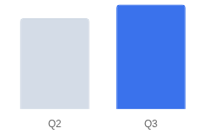




Module 8
Weak vs. Strong Slides
Weak Design
Strong Design
Sales Data
Q3 Sales Increased 15% Due to New Strategy
In the third quarter of the fiscal year, we observed a significant uptick in overall sales performance across the majority of our operating regions. This increase can be attributed to several factors, including but not limited to the implementation of the new marketing strategy, seasonal demand fluctuations, and improved sales team efficiency. Specifically, the data shows a 15% increase compared to the previous year. It is crucial to note that while the North region performed exceptionally well, the South region remained relatively stagnant. Moving forward into Q4, we need to consider allocating more resources to the underperforming areas to ensure balanced growth.
Primary Driver: Client retention campaign launched in July.
Top Region: North region exceeded targets by 25%.
Recommendation
Scale strategy to 3 remaining regions in Q4.
Region | Q2 | Q3
North | 100 | 125
South | 90 | 92
Why it fails:
Why it works:
Generic topic label ("Sales Data") instead of a message.
Headline tells the story instantly (Takeaway).
Dense "wall of text" forces audience to read, not listen.
Visuals support the data; text is minimal and scannable.
07
No clear takeaway or action item.
Clear recommendation/next step highlights value.

Slide 8




Module 8
Professional Delivery Tips
Pace: Slow down slightly; aim for clarity over speed
Pause: Let key points land; breathe between sections
Signposting: Guide listeners with "First… Next… Finally…"
Presence: Maintain confident posture, eye contact, & open gestures
Close Strong: End with a clear takeaway & explicit next step
08

Slide 9




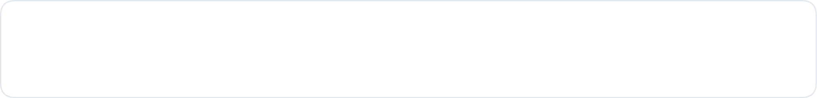



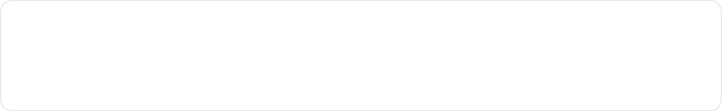






Module 8 Case Study
Why It Worked
The Presentation That Got Approved
The Approval Formula
The Narrative
Clear Problem
The Opener (Hook)
"We’re losing $2,000 a month due to delayed shipments."
Clear Recommendation
The Analysis
Presented 3 potential vendors with clear criteria comparison: cost, speed, and reliability ratings.
Clear Next Step
The Recommendation
Recommended "Vendor B" immediately—highlighting they offer the best balance of speed and cost.
DECISION
Approved on the spot
The Close (Next Step)
09
"I’ll send contracts by Friday if you approve today."

Slide 10



Module 8 • Part 2
Career
Communication
Shifting focus from presentation delivery to high-impact professional documents that get you hired.
Impact Résumé
Tailored Emails
Professional Fit
10

Slide 11





Module 8
The Impact-Focused Résumé
Employers look for results, not just responsibilities. Emphasize outcomes over duties.
The Impact Formula
Action
+
Task
+
Result
+
Context/Tool
Applied Example
"Led a team of 5 to redesign onboarding, reducing training time by 30% using workflow automation tools."
Action
Task
Result (Metric)
Context/Tool
11

Slide 12










Module 8
Weak vs. Strong Résumé Bullets
Weak Bullets
Strong Bullets
Professional Experience
Professional Experience
Responsible for social media accounts.
Managed social media for 3 brands, increasing engagement by in 6 months via analytics-led content strategy.
40%
Worked on customer service issues.
Helped with project planning duties.
Resolved ~25 tickets/day, lifting CSAT from 4.1 to using a new triage script.
4.6
Duties included writing reports.
The Impact Formula Applied:
Action (Managed)
Task (Social Media)
Result (+40%)
Why it fails:
Why it works:
Focuses on duties ("Responsible for") rather than results.
Starts with strong Action Verbs.
Vague language gives no sense of scale or skill.
Includes specific Metrics to prove value.
Missing proof of value (no numbers).
Follows the Impact Formula (Action + Task + Result).
12

Slide 13


Module 8 • Career Communication
The Tailored Cover Letter
Opening Paragraph Structure & Strategy
The Opening Formula
How you learned about the role(mention specific connection or source)
Why you’re interested(align directly to mission & values)
Your fit in one sentence(state role + 2–3 key qualifications)
Connect your skills directly to the company’s specific needs
13
Keep the tone specific, concise, and professional

Slide 14








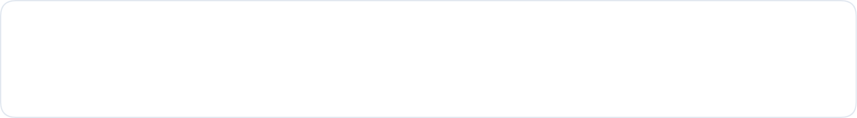


Module 8 Case Study
The Email That Got the Interview
Why It Worked
The Response Formula
The Approach
Specificity
The Connection
"I’m a marketing major at State College, and I follow your work in youth literacy."
Relevance
The Evidence
Proof of capability: "Last semester, I led a fundraising campaign that raised $5,000 for a similar cause."
Clear Ask
RESPONSE
The Ask
"I’d love to discuss how I can contribute to your spring campaign."
Got the Interview
14

Slide 15








Module 8 Assignment
Presentation Checklist
Ensure your final presentation meets these critical criteria before submission.
Clear Purpose
Logical Structure
Stated explicitly at the beginning.
Follows the 3 key points format.
Readable Slides
Supporting Evidence
One idea per slide, minimal text.
Examples or data for each point.
Clear Recommendation
Timing Adherence
Includes specific next steps.
3–6 min (recorded) or 5–8 min (live).
Pro Tip
Review your recording twice: once for audio clarity and once for slide timing.
15

Slide 16





Career Readiness
Career Package Checklist
Verify these essential elements in your application materials before hitting send.
Clean Formatting
Impact Bullets
Consistent fonts, spacing, alignment.
Action + Task + Result + Context/Tool.
Tailored Letter
Professional Tone
Specific company, role, and cultural fit.
Confident, polite, and no slang.
Proofreading
Zero grammar or spelling errors.
Final Step
Always save and submit your documents as PDFs (unless asked otherwise) to preserve formatting across all devices.
16

Slide 17





Module 8 Summary
Key Takeaways
Audience-First Mindset
Visuals Support Words
1
2
Presentations aren't about you; they are about what the audience needs to know and do. Structure your message logically to guide them from a hook to a decision.
Adhere to design rules: one idea per slide, headline-style takeaways, and minimal text. Use visuals to enhance understanding, not just to decorate.
Impact-Focused Documents
Clear Recommendations
3
4
Reviewers scan for value. Use the Impact Formula (Action + Task + Result) in résumés and tailor every cover letter to specific company needs.
Whether presenting a proposal or applying for a job, always end with a clear recommendation and a specific, time-bound next step to drive action.
High-Impact Professional Communication
17

