Slide 1


Business Communication Series
Module 6:
Persuasive Communication
Ethical, evidence-based persuasion for business results
Dr. Liz Kheng

Slide 2







Introduction
Module Overview
In business, you often need buy-in. This module focuses on persuasive writing that is ethical, evidence-based, and tailored to the reader's priorities.
Purpose
Gain buy-in through clear, ethical, reader-focused messages that respect the audience's intelligence.
Approach
Prioritize tangible evidence, specific benefits, and professional credibility over marketing hype.
Focus
Mastering the AIDA model and key strategies: building credibility, features vs. benefits, and addressing objections.
Core Competency
"Effective persuasion connects your goals with the reader's needs."
Outcomes
Ability to draft strong requests, proposals, and internal/external messages that drive action.

Slide 3






Module Goals
Learning Objectives
By the end of this module, you will have the tools to transform your business communication into a powerful asset for achieving organizational goals.
Reader-Centricity
Write persuasive messages using tangible benefits and reader-focused reasoning.
Credibility
Build trust and authority with solid evidence, professionalism, and appropriate tone.
Objection Handling
Target Outcome
Anticipate potential concerns and address objections directly and respectfully.
"Mastery of ethical persuasion techniques to drive tangible business results."
Ethical Persuasion
Use ethical persuasion principles without resorting to manipulation or misleading claims.

Slide 4

Persuasive Structure
The AIDA Model
A logical journey guiding readers from awareness to action
Hook the Reader
Attention
Start with a startling fact, a compelling benefit, or a relevant problem to grab focus immediately.
Build the Case
Interest
Provide specific facts, details, and logical reasoning to explain how the solution works.
Prove the Value
Desire
Show direct benefits to the reader (WIIFM) supported by proof like data or testimonials.
Action
Request Next Steps
Make a specific, clear, and easy-to-follow request. Tell them exactly what to do next.
Most common structure for sales emails, proposals, and persuasive requests.

Slide 5







Example: Step-by-Step
Applying AIDA in Business Writing
Putting the model into practice for internal requests
Step 1: Attention
Scenario
"Our team spends 10 hours a week manually entering data."
Hook: Highlight the pain point (wasted time).
Requesting New Software
Step 2: Interest
The Goal: Convince management to purchase a new automation tool.
"New software automates this, saving approx. 500 hours a year."
Facts: Explain the solution and quantify the impact.
The Audience: A busy Finance Director focused on ROI and efficiency.
Step 3: Desire
"This frees us up for high-value client work, increasing revenue."
Benefit: Connect the saving to a larger business goal (WIIFM).
"Don't just ask for the tool. Sell the solution to a problem they care about."
Step 4: Action
"Can we schedule a demo next Tuesday?"
Close: Specific, easy, low-friction request.

Slide 6









Strategy Focus
Building Credibility
Persuasion fails without trust: 4 keys to establishing authority
01
02
Lead with Facts & Sources
Demonstrate Expertise
Avoid hyperbole like "best ever." Instead, rely on specific data, concrete evidence, and cite credible sources to ground your claims in reality.
Briefly mention relevant experience or qualifications without boasting. Show you understand the subject matter deeply through your analysis.
03
04
Maintain Professional Tone
Show Reliability
Stay objective and measured. Emotional, aggressive, or overly casual language reduces trust. Confidence comes from clarity, not volume.
Demonstrate attention to detail through accurate data, clean formatting, and timely follow-up. Reliability in presentation implies reliability in execution.
CORE PRINCIPLE: Credibility is earned through consistency and evidence, not just titles.

Slide 7









Comparison Strategy
Features vs. Benefits
Translating product facts into reader value
CORE CONCEPT
WIIFM: "What's In It For Me?"
Readers don't buy what a product is; they buy what it does for them.
The Feature
The Benefit
The Fact / The Spec
The Value / The Outcome
Hardware Spec
User Outcome
"This laptop has a 24-hour battery life."
"Work through flights and all-day conferences without hunting for an outlet."
Software Spec
"Includes AI-assisted rendering tools."
User Outcome
"Deliver proofs 30% faster and handle more clients per month."
Tip: Connect features to benefits using the phrase "which means that..."

Slide 8

















Scenario Analysis
Addressing Objections
Anticipate doubt and respond with solutions, not excuses
The Proposal
Switch to a 4-Day Work Week
Proposed to improve employee morale and reduce burnout.
The Counter-Argument
Staggered Schedules
"We will ensure 5-day coverage by splitting the team:"
Team A
MON
TUE
WED
THU
FRI
MON
TUE
WED
THU
Covered
Team B
FRI
The Objection
"Clients can't reach us on Fridays."
Result: Clients still get 5-day service.
Benefit: Morale boosts productivity during active hours.
"If we are closed 20% of the week, our service levels will drop and we might lose contracts."
Objection Handling Checklist
Acknowledge Respectfully
Provide Evidence
Reiterate Benefits
Don't dismiss fears; validate them.
Use data or logic to mitigate risk.
Remind them of the positive outcome.

Slide 9




Ethical Strategies
Ethical Persuasion
Persuasion is not manipulation. While manipulation relies on deception or coercion, ethical persuasion uses truth, logic, and emotional intelligence to help people make informed choices.
Persuasion vs. Manipulation
Ethical persuasion respects the reader's autonomy and intelligence. It presents the best case for a mutually beneficial outcome without hiding the truth.
Guiding Principles
Maintain transparency about motives, ensure all claims are proportional to the evidence, and respect the audience's right to say no.
The Golden Rule
"Ethical persuasion prioritizes long-term trust over short-term wins secured through deception."
Red Flags to Avoid
Steer clear of misleading statistics, omitting crucial downsides, undue pressure (e.g., false scarcity), and hidden trade-offs.

Slide 10
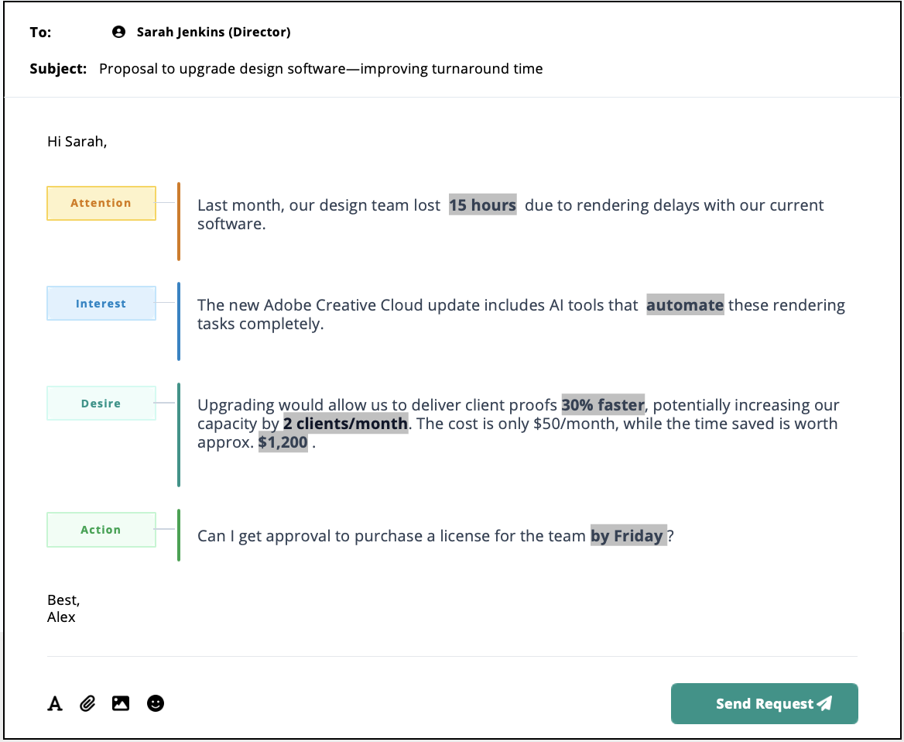



Practical Example
Persuasive Request Email
See the AIDA model applied in a real-world internal request
The Objective
Secure budget approval for new software by focusing on ROI rather than just features.
Key Strategy
Notice how the "Desire" section quantifies the benefit ($1,200 saved) to make the cost ($50) seem trivial.

Slide 11






Best Practices
Common Persuasion Mistakes
Replace ineffective habits with persuasive techniques
Avoid These Mistakes
Do This Instead
Self-Centered Focus
Reader-Centered Focus
Focusing on "me" instead of "you".
Focusing on benefits to the reader.
"I want / I need..."
"You will get / You will benefit..."
Vague Requests
Specific Details
Using general terms that lack impact.
Using specific specs and reasons.
"We need better computers."
"We need 16GB RAM for video editing."
Pushy Tone
Soft Urgency
Creating resistance with demands.
Creating urgency via opportunity.
"You must do this now."
"Act by Friday to secure the discount."

Slide 12








Module 6 Conclusion
Summary & Key Takeaways
Effective persuasion is a skill that blends psychology, logic, and empathy. By mastering these principles, you move from simply informing your audience to inspiring them to act.
Guide with AIDA
Structure messages to guide readers logically from Attention to Interest, Desire, and finally Action.
Lead with Benefits
Shift focus from "I need" to "You get." Translate product features into tangible outcomes that solve the reader's problems.
Build Trust & Address Doubts
Your Next Steps
Establish credibility with evidence and a professional tone. Anticipate objections and address them directly with data-backed answers.
"Apply the AIDA model to your next request."
Ethical Persuasion
Draft your message using the framework
Persuade without manipulation. Be transparent, respectful, and always end with a clear, specific Call to Action.
Translate features into benefits
Seek peer feedback before sending

