Slide 1

Module 4
Positive Routine Messages
Building credibility in everyday communication
Mastering the art of direct, clear, and courteous routine messages to build trust, save time, and strengthen professional relationships.
Presented by Dr. Liz Kheng
Business Communications

Slide 2




Module 4 Overview
Learning Objectives
By the end of this module, you will be able to:
Write clear requests
Structure routine asks to get faster, better responses with minimal friction.
Write helpful responses
Anticipate reader questions to prevent unnecessary back-and-forth emails.
Confirm information accurately
Create reliable records of dates, expectations, and next steps.
Craft goodwill messages
Build professional relationships through sincere, specific appreciation.
"Efficiency meets courtesy"
Module 4: Positive Routine Messages
Page 2

Slide 3


Professional Communication
Why Routine Messages Matter
Routine doesn't mean unimportant—your daily messages shape your professional reputation.
Most workplace communication is routine
These daily touchpoints are where you build credibility and demonstrate competence.
Clarity saves time
Precise messages reduce confusion and prevent endless back-and-forth email chains.
Consistency builds trust
Reliable communication patterns make you a dependable partner for colleagues and clients.
Tone improves collaboration
Inclusive, courteous language fosters goodwill and makes others want to work with you.
"Reputation is built one message at a time"
Module 4: Positive Routine Messages
Page 3

Slide 4





Routine Strategy Framework
Strategy: The Direct Approach
Most routine messages should state the main idea immediately. This "front-loading" respects the reader's time and reduces cognitive load.
When to Use
Best for low-stakes, expected, or standard requests where the reader is likely to comply or needs the information quickly.
Core Principles
Lead with main point: State the request or answer in the first sentence.
Add relevant details: Include only necessary context, deadlines, or links.
Close with goodwill: End with a professional sign-off or clear next step.
Required Tone
Professional, concise, and respectful. Avoid "hedging" (e.g., "I was wondering if...") which can sound unconfident or confusing.
"Get to the point quickly"
Module 4: Positive Routine Messages
Page 4

Slide 5




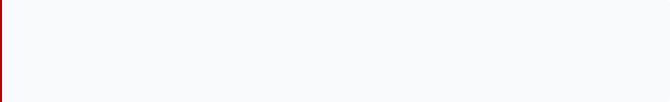
Strategy Framework
Direct Request Pattern
The 3-step flow for routine clarity
1
2
3
Main Idea
Key Details
Closing
State the ask up front
Context, specifics, links
Deadline + thanks/next step
Don't bury the request. Start with exactly what you need so the reader knows the purpose immediately.
Provide necessary background, specific data points, attachments, or links needed to fulfill the request.
End with a clear deadline, a specific next action, and a courteous sign-off to maintain goodwill.
Example
Requesting the Q3 Report
1. Main Idea
2. Key Details
3. Closing
"Please send the Q3 report."
"I’m compiling the board deck; need sales + costs data."
"By Thu 2 PM ET. Thanks!"
Module 4: Positive Routine Messages
Page 5

Slide 6

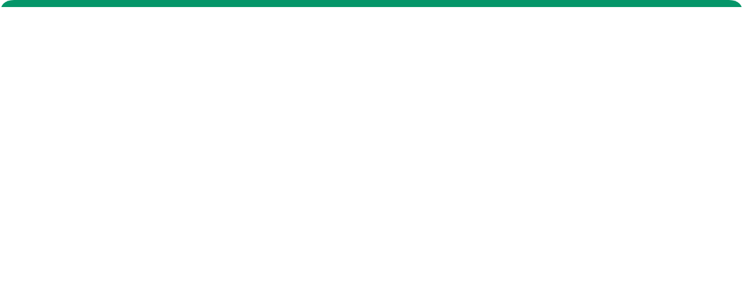
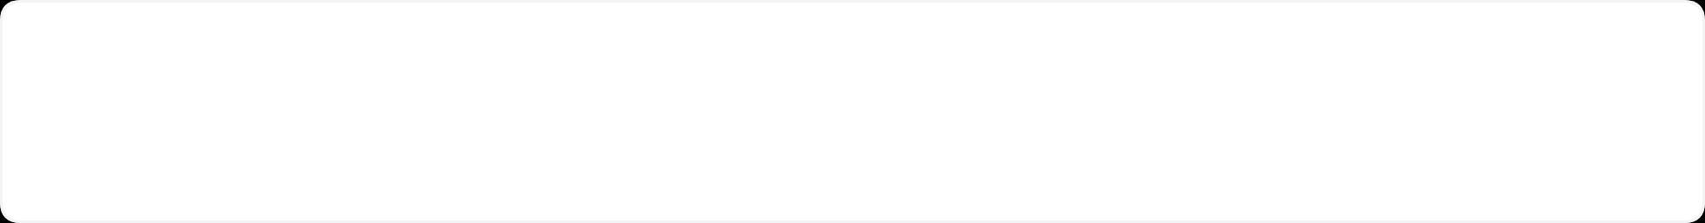




Why It Works
Benefits of the Direct Approach
Faster reader comprehension
Reader knows the "what" and "why" immediately
Efficiency
"The direct approach respects the reader's intelligence and their time."
Fewer misinterpretations
Clarity reduces the risk of confusion or missed details
Shorter email chains
Impact
Clear requests lead to complete answers, reducing back-and-forth
Routine messages build your reputation for reliability. Consistent clarity signals competence.
Professional tone without fluff
Respects the reader's time while maintaining courtesy
Easier to skim on mobile
Structured content works better on smaller screens
Module 4: Positive Routine Messages
Page 6

Slide 7
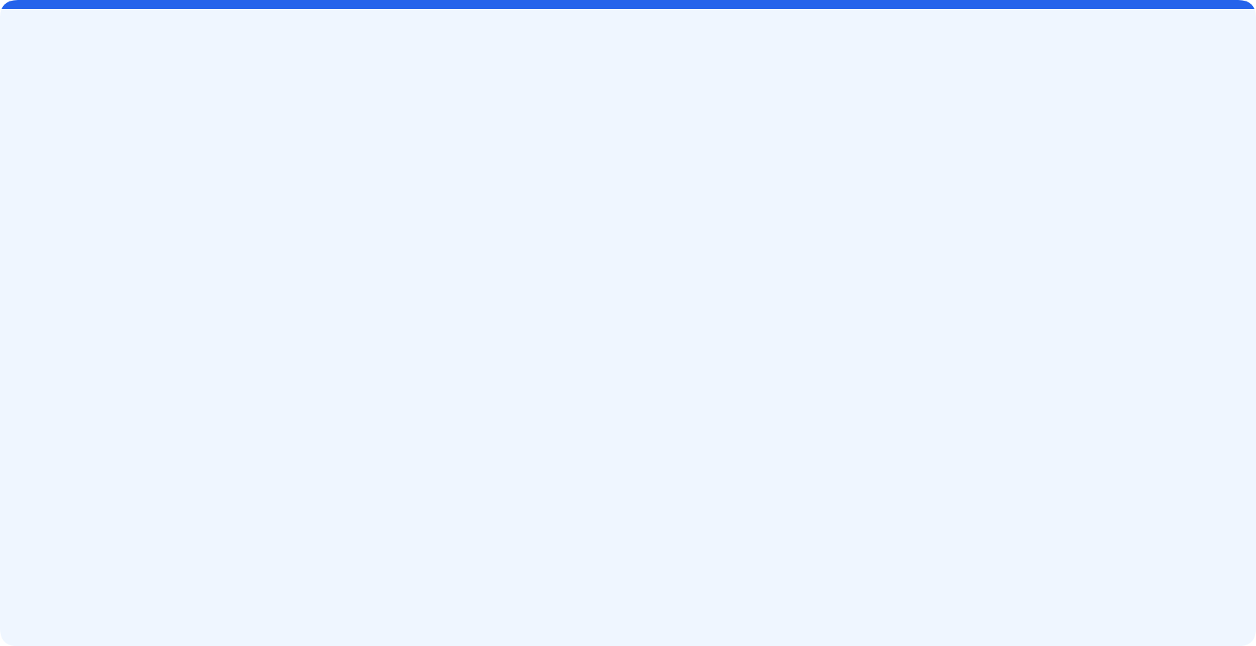















Message Categories
Types of Routine Messages
Four key pillars of daily communication
Requests
Responses
Information & Action
Answers & Solutions
Asking for specific information, action, or permission. The goal is to make it easy for the reader to say "yes" and act quickly.
Providing answers, help, or next steps. Good responses anticipate follow-up questions to prevent unnecessary email chains.
"Please send the Q3 report by Friday."
"Here is the data. Note that column B is updated."
Confirmations
Goodwill
Documentation & Agreement
Relationships & Trust
Creating a written record of verbal agreements, meetings, or instructions. Vital for accountability and clarity on deadlines.
Messages designed purely to build relationships, such as thank-you notes, congratulations, or appreciation. Sincere and specific.
"To confirm our call: Launch is set for Oct 15."
"Great job leading the presentation today."

Slide 8






Routine Requests
Request Messages: Purpose & When to Use
The foundation of workplace efficiency: getting what you need clearly and professionally.
Purpose
Get information or action efficiently without unnecessary preamble.
When to Use
When the reader expects the request as part of their role (no persuasion needed).
The Essentials
Clear ask + Specifics + Deadline + Courtesy.
Subject Line Format
Request: [Item] by [Date/Time]
"Directness respects the reader's time"
Module 4: Positive Routine Messages
Page 8

Slide 9




Before & After Comparison
Request Message Effectiveness
Moving from vague to actionable
Weak Request
Needs Improvement
Strong Request
Professional Standard
Draft
Sent
To:
Sarah Jenkins
To:
Sarah Jenkins
Subject:
(No Subject)
Subject:
Request: Alpha Budget Update by Fri 12 PM
Hi, hope you're well.
Hi Sarah,
I was wondering if you might have time to check the budget numbers.
Could you send the updated Alpha budget (tabs: Sales, Costs) by Friday at 12 PM?
Thanks.
I'm finalizing the proposal for the board meeting and need the latest figures to complete section 4.
Thanks!
Why it fails:
Why it works:
Missing subject line (easy to ignore)
Subject line states topic + deadline
Vague request ("check numbers" vs "send updated file")
Direct request in the first sentence
Indirect phrasing ("wondering if you might")
Specific details (which tabs needed)
No deadline or context provided
Clear reason ("finalizing proposal") motivates action

Slide 10
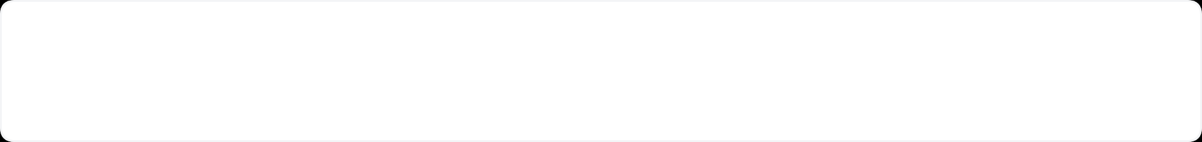


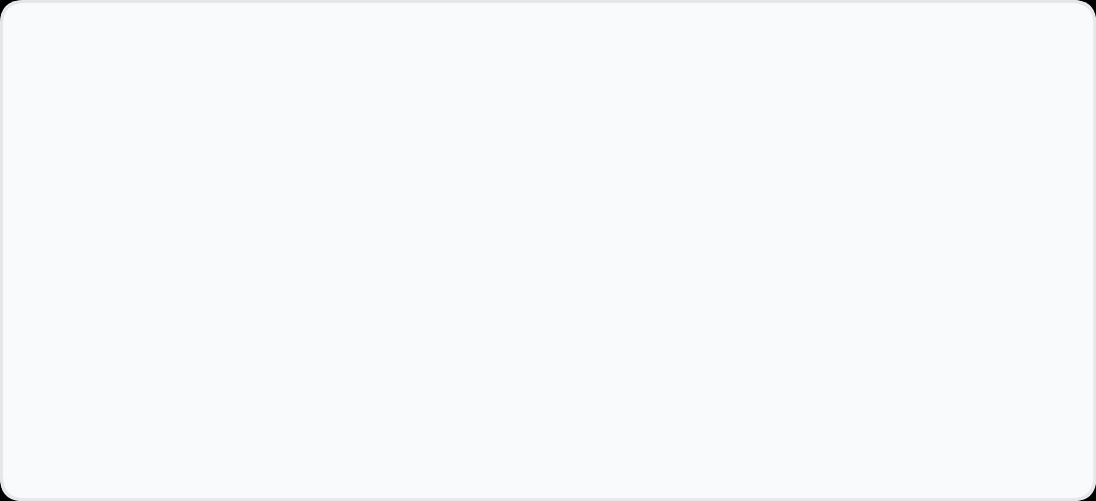
Effective Communication
Request Messages:
Best Practices
Lead with the ask
State your request clearly in the first sentence
Clarity First
Include exact deadline
"A clear request respects the recipient's time and increases response rates."
Specify date + time + time zone to avoid confusion
Bullet specifics
List files, fields, tabs, or links for quick scanning
Subject: Q3 Data Request - Due Fri 2PM
Provide brief context
Explain why it matters so the reader understands the urgency
Offer flexibility/fallback if needed
Suggest alternatives if the primary request isn't feasible
Keep tone courteous; avoid hedging
Be polite but direct—confidence builds professional trust
Page 10

Slide 11





Effective Communication
Response Messages: Purpose & Approach
Purpose: Answer clearly and anticipate next needs to provide a complete resolution.
Answer the question first
Provide the core answer immediately rather than burying it in context.
Add helpful info
Include relevant options, links, or next steps that the reader might need.
Confirm timing/ownership
Clarify who does what by when to reduce follow-up emails.
"Be helpful, be efficient"
Module 4: Positive Routine Messages
Page 11

Slide 12










Real-World Scenario
Case Study: The Helpful Response
Turning a "No" into a Service Opportunity
Customer Inquiry
"Hi, I saw this item on your website. Do you have this in blue?"
The "Dead End" Response
Weak
The "Helpful Path" Response
Strong
You
To: Customer
You
To: Customer
No, we don't.
Thanks for checking! We don't have the blue in stock right now, but we do have navy and teal available.
If you prefer the blue, I can:
Check our downtown store for you
Notify you when our next shipment arrives (ETA: Tuesday)
Let me know what works best!
Result: Conversation ends. Customer leaves.
Result: Relationship maintained. Options provided.
Key Strategy
Step 1
Step 2
Step 3
The Helpful Response Formula
Direct Answer
Alternatives
Action Path
"No, but..."
"We have navy..."
"I can check..."

Slide 13
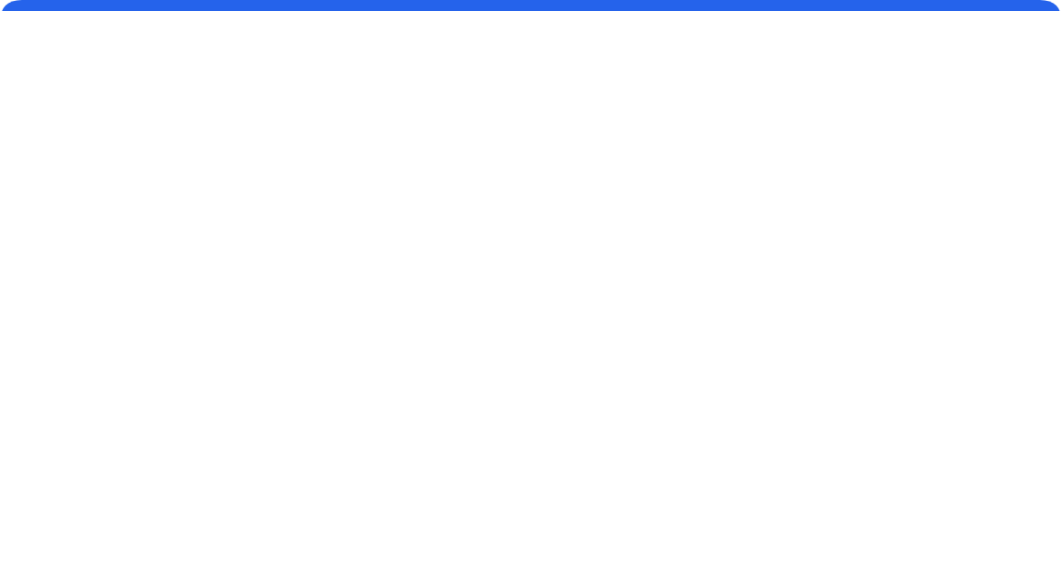


Proactive Communication
Responses: Anticipate Follow-up Questions
Provide concise answer first
Proactive Response Example
Don't bury the "yes" or "no" in paragraphs of explanation
"Yes, we can adjust the timeline."
"I've attached the revised schedule with the new dates highlighted. Please review the milestones on page 2."
Offer 1-2 alternatives (if "no")
"Does this align with your team's availability?"
Provide viable options to keep the conversation moving forward
Include links/SKUs/attachments
Why it matters
Give the reader everything they need to take action immediately
"Anticipating questions saves everyone an extra email loop. It shows you're thinking ahead."
Clarify timelines and next steps
State clearly who does what by when to avoid confusion
Invite confirmation: "Does this work?"
Ensure alignment before moving forward to next stages
Module 4: Positive Routine Messages
Page 13

Slide 14




Module 4: Confirmation Messages
Purpose & Timing
Prevent errors by creating a reliable written record of verbal agreements.
Purpose
Create a formal written record to eliminate ambiguity and prevent costly errors.
When to Use
Immediately after meetings, phone calls, verbal approvals, schedule changes, or key decisions.
Key Benefits
Establishes shared memory, ensures accountability, and clarifies owners and deadlines.
"If it's not written down, it didn't happen"
Module 4: Positive Routine Messages
Page 14

Slide 15
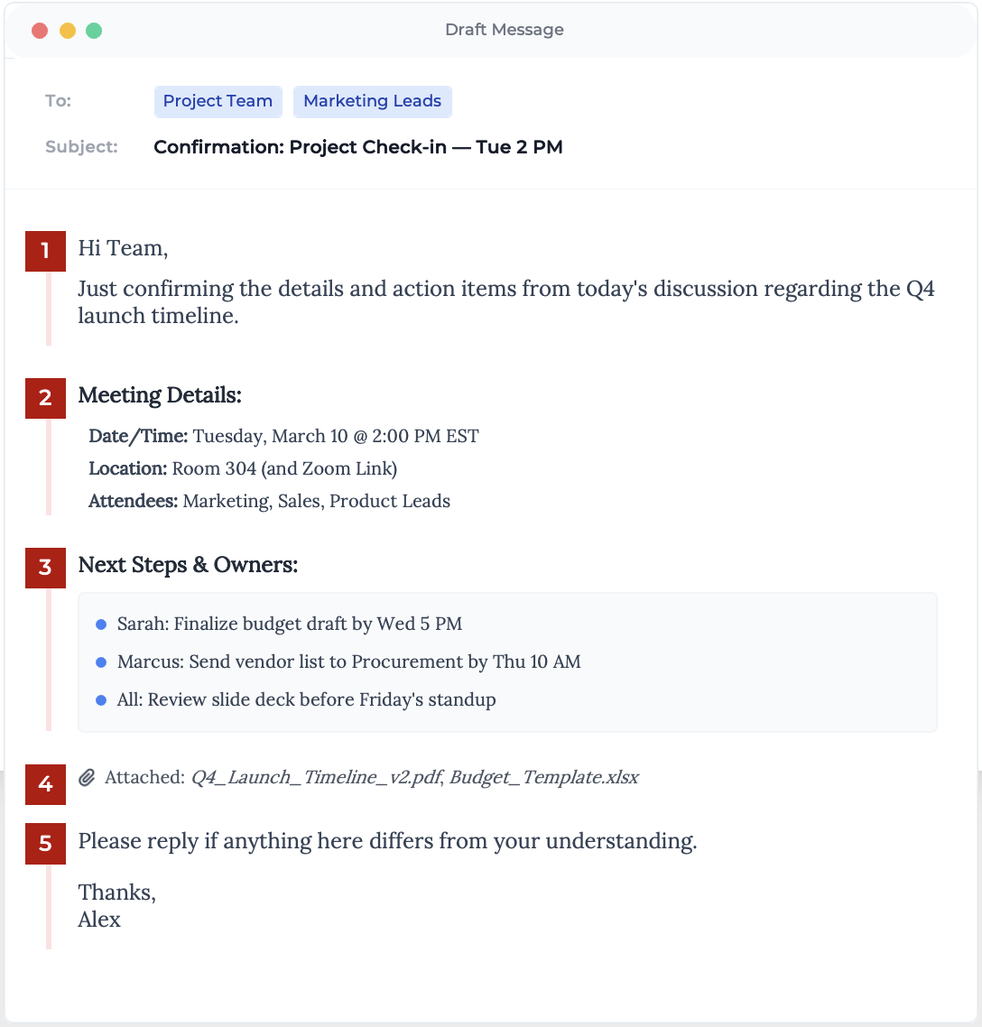



Structure & Template
Confirmation Pattern
Creating a shared record of truth
Why Use This Template?
Verbal agreements are easily forgotten. This structure creates accountability and prevents "I didn't know" excuses later.
Captures key logistics clearly
Assigns ownership to tasks
Invites correction immediately
Best Practice Tip
"Send confirmation emails within 24 hours of the meeting or discussion while details are fresh."

Slide 16




Checklist
Confirmation: Best Practices
Mirror dates with weekday
Accountability
Example: "Tue, Mar 10, 2 PM ET" ensures clarity across calendars.
"Written confirmation creates a shared reality and prevents costly misunderstandings."
Use bullets for logistics
Make key details scannable rather than buried in paragraphs.
Assign owners by name/role
Clearly state who is responsible for each action item.
Protection
Confirmations protect both sender and receiver by documenting agreements, deadlines, and responsibilities clearly.
Include files/links in-line
Provide direct access to relevant documents within the message.
Ask for correction if details differ
Invite the recipient to confirm accuracy: "Let me know if anything is amiss."
Module 4: Positive Routine Messages
Page 16

Slide 17






Relationship Building
Goodwill Messages:
Purpose & Uses
Sincere communication that strengthens professional bonds without an underlying agenda.
Purpose: Strengthen Relationships
Build trust and connection with sincerity, not strategy. Authenticity is key.
Use For: Professional Milestones
Perfect for thanks, congratulations, kudos, welcoming new team members, and celebrating achievements.
Guideline: The "No Ask" Rule
"People may forget what you said, but they will never forget how you made them feel."
Keep it Selfless, Specific, and Short. Never include a hidden request or business agenda.
Module 4: Positive Routine Messages
Page 17

Slide 18

Goodwill Framework
The 3 S's of Goodwill Messages
Selfless, Specific, Short
1
2
3
Selfless
Specific
Short
Focus on them
Name the action
Concise & readable
Keep the spotlight entirely on the recipient. Avoid making it about you or including hidden requests.
Vague praise feels insincere. Mention exactly what they did well to show you truly noticed.
Keep it brief (2-4 lines). Long messages can feel burdensome to read or overly dramatic.
Examples
1. Selfless
2. Specific
3. Short
"Your extra effort made onboarding smoother."
"You resolved 12 tickets in 48 hours."
"Great work handling the client today. I appreciate your focus."
Module 4: Positive Routine Messages
Page 18

Slide 19












Relationship Builders
Goodwill Message Examples
Sincere, Specific, and Short
Thank You
Congratulations
Appreciation
Gratitude & Recognition
Achievements & Milestones
Qualities & Effort
Use when someone goes above and beyond or helps you achieve a goal.
Use for promotions, completed projects, awards, or personal milestones.
Use to acknowledge specific behaviors, skills, or attitudes in the moment.
"Thank you for staying late to finish the client brief. Your dedication ensured we met the morning deadline."
"Congrats on the promotion to Senior Analyst—well deserved! I know you've worked hard for this."
"I really appreciate your calm under pressure during the outage today. It kept the whole team focused."
"Your detailed notes from the meeting really helped the team move faster on the next phase. Thanks!"
"A huge round of applause for leading a successful product launch. The customer feedback is already fantastic."
"Great facilitation in the workshop—you kept us on track despite the tight agenda."
Module 4: Positive Routine Messages
Page 19

Slide 20











Module Wrap-Up
Summary & Key Takeaways
Core principles for routine success
Direct Approach Strategy
Direct Request Pattern
Use for all routine messages. Lead with the main idea immediately, follow with details, and close with goodwill.
Structure: Main Idea → Details → Closing. Ensure every request has a clear ask, specific details, and a concrete deadline.
Helpful Responses
Confirmations & Goodwill
Don't just answer the immediate question. Anticipate follow-up needs and provide next steps to reduce email ping-pong.
Document details to create accountability. For goodwill, use the Selfless, Specific, Short framework to build genuine relationships.
Immediate Application
Build Your Professional Reputation
4
1
Types
Strategy
"Save these templates and reuse them consistently to establish reliability."
Module 4: Positive Routine Messages
Page 20

