Slide 1












Business Communication Course
Module 3:
Visual Messages +
Clear Writing
Make meaning easy to see and easy to understand.
Overview: Visual hierarchy, ethical charts, clear sentences, coherent paragraphs, and hands-on practices.
Visual Data
|
Writing Clarity
|
Structure

Slide 2









Module 3 Goals
Learning
Objectives
Design Scannable Messages
Structure content so readers can capture meaning in seconds.
Choose the Right Visual Format
By the end of this module, you will be able to apply these five critical skills in your professional communication.
Select the best tool (table, chart, diagram) for your data story.
Avoid Misleading Visuals
Create ethical, accurate charts that build credibility.
Write Clear, Concise Sentences
Eliminate clutter and ambiguity to respect your reader's time.
Build Coherent Paragraphs
Guide readers logically from main point to supporting details.
MODULE 3: VISUAL MESSAGES + CLEAR WRITING

Slide 3






The Business Context
Why Visual
Communication
Matters
Readers Skim Under Pressure
Most professionals spend only seconds deciding if an email or document is worth reading. Dense text gets skipped.
Visuals Direct Attention
Headings, bold text, and charts control what the reader notices first and what feels urgent.
In the workplace, your reader is often moving fast—scanning between meetings, switching tasks, and making decisions with limited time.
Reduce Cognitive Load
Well-designed messages make meaning easy to see instantly, requiring less mental effort to understand.
Design is part of the message, not an afterthought.
Shape Perceived Importance
Visual hierarchy signals what matters most. Without it, everything looks equally important (or unimportant).
MODULE 3: VISUAL MESSAGES + CLEAR WRITING

Slide 4


Module 3 • Section 1
05
In This Chapter
1
Visual Communication Principles
Communicating Your
Messages Visually
Why design is part of the message
2
Reader Scanning Patterns
How people actually read content
3
Chart Selection Guide
Choosing the right visual tool
Visual communication is not decoration—it's meaning. Learn how to design for skimmers, choose the right charts, and maintain ethical standards.
4
Ethical Visuals
Avoiding misleading charts

Slide 5






Visual Hierarchy
Visuals Convey
Meaning
Visual Hierarchy Controls:
What Is Seen First
Design guides the eye. The most visually prominent element is the entry point for understanding.
Visual communication isn't just decoration—it fundamentally shapes how your message is interpreted and prioritized.
What Feels Important
Size, bolding, and color signal urgency and priority without saying a word.
What Gets Ignored
Dense text blocks and cluttered layouts cause readers to skip critical information.
Key Design Tools:
Headings
Contrast
Grouping
Proximity
Whitespace
MODULE 3: VISUAL MESSAGES + CLEAR WRITING

Slide 6










Visual Hierarchy
How Readers Actually Read
"Design for skimmers first; details second."
1
3
5
2
4
Subject Line / Title
Bullets / Bold Phrases
Visuals
The hook. Readers decide here if the message is relevant to them.
Charts & Graphics. Often processed simultaneously or immediately after title.
Headings
Key takeaways. Eyes are drawn to lists and emphasized text.
First Sentences
Signposts. Used to navigate to the specific section they need.
Topic sentences. They read the start of paragraphs, skimming the rest.
Key Insight: Most readers will skip dense blocks of text entirely.
MODULE 3: VISUAL MESSAGES + CLEAR WRITING

Slide 7







Visual Formatting Case Study
Scenario: A supervisor sends an order request. Formatting determines whether the reader sees the critical "premium" requirement or misses it entirely.
The Email That Cost $2,000
Before: Buried Information
Low Visual Hierarchy
After: Structured Formatting
High Visual Hierarchy
Subject: Supplies for event
Subject: URGENT: Event Supply Order (Due Friday)
Hi Team,
Hi Team,
Please order the supplies for the event next week we need 10 table tents make sure they are the premium package not the standard one and also 2 vinyl banners also premium package and have them delivered by Friday noon.
Please place the following order for next week's event:
Order Details (Use PREMIUM Package):
10 table tents
(PREMIUM package)
2 vinyl banners
Thanks,
Manager
(PREMIUM package)
Delivery Instructions:
Friday by 12:00 PM to Student Center Desk.
What went wrong?
Why it works
Thanks,
Manager
Dense text block. "Premium package" is buried in the middle. Reader scans quickly, misses the detail, orders standard items. Result: Reprint cost ($2,000).
Headings signal topic. Bullets break up items. Bold text highlights "PREMIUM" and deadline. Reader cannot miss the critical requirement.
MODULE 3: VISUAL MESSAGES + CLEAR WRITING
Visuals save money by preventing errors

Slide 8





Visual Hierarchy
Visual Structure
Best Practices
Use Specific Headings
Break content with descriptive subheads that tell the reader what each section contains before they read it.
Use Bullets for Lists
Convert series of items into vertical lists to make them instantly scannable and easier to digest.
Effective visual structure transforms dense text into actionable information by guiding the reader's eye.
Bold Key Actions & Terms
Highlight critical information, deadlines, or action items so they stand out even when skimming.
Leverage Whitespace
Use empty space to group related items and separate distinct ideas, reducing visual clutter.
Write Short Paragraphs
Keep blocks of text brief (3-5 lines max) to appear inviting rather than intimidating to busy readers.
MODULE 3: VISUAL MESSAGES + CLEAR WRITING

Slide 9







Visual Strategy
Choosing the
Right Visual
Show a Trend over Time Line Chart
Best for visualizing continuous data changes, growth, or decline over a period.
Don't just decorate—communicate. Match your specific data goal to the most effective visual format to ensure instant comprehension.
Compare Categories Bar Chart
Best for ranking items, comparing magnitudes, or showing differences between groups.
Display Exact Values Table
Best when precise numbers are more important than visual patterns or shapes.
"The wrong chart forces the reader to work harder to find the meaning."
Show Part-to-Whole Pie Chart
Best for simple percentage breakdowns (limit to 5 slices max).
Visualize a Process Flowchart
Best for showing sequences, decision points, ownership, or workflows.
MODULE 3: VISUAL MESSAGES + CLEAR WRITING

Slide 10

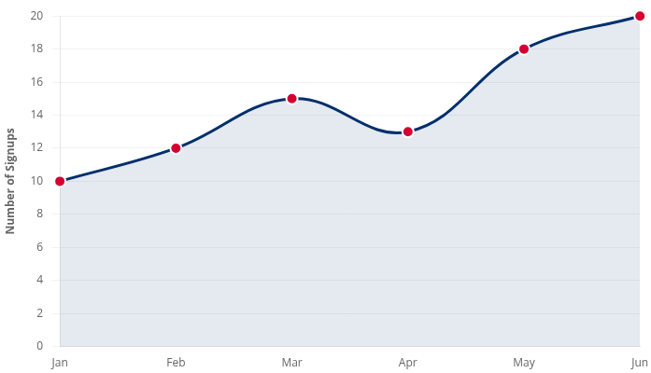



Visualizing Trends
Line Chart Demo: Monthly Signups
"Use line charts to show continuous change over time."
Live Data
User Acquisition Trend (Jan-Jun)
Overall Trend
Signups have doubled over the 6-month period, showing strong consistent growth despite minor fluctuations.
Critical Dip
The April dip (-13%) correlates with the server downtime incident, but recovery was immediate in May.
Visual Tip: Notice how the Y-axis starts at 0 to maintain truthful scaling (ethical design).
MODULE 3: VISUAL MESSAGES + CLEAR WRITING
Chart.js Visualization

Slide 11
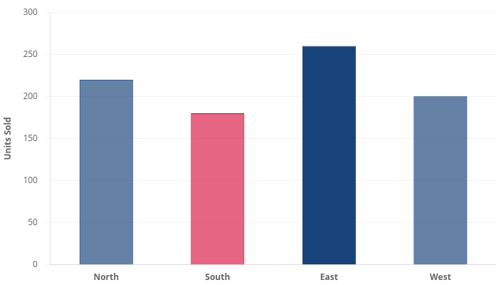



Comparing Categories
Bar Chart Demo: Sales by Region (Q2)
"Use bar charts to compare distinct categories or groups."
Q2 Performance
Regional Sales Comparison
Top Performer
The East Region leads with 260 units, outperforming the lowest region (South) by nearly 45%.
Growth Opportunity
Target the South Region (180 units) for Q3 growth initiatives to bridge the gap with the West.
Visual Tip: Horizontal bars work well for long category names; vertical bars are best for time or short labels.
MODULE 3: VISUAL MESSAGES + CLEAR WRITING
Chart.js Visualization

Slide 12






Visualizing Exact Values
Table Demo: Budget vs. Actual (Q2)
"Use tables when readers need to look up precise numbers."
Key Insight
Departmental Spending Report
Currency: USD ($)
Operations is over budget by $5k, which offsets the savings from Marketing and IT. The total variance is negative.
Department
Budget
Actual
Variance
Marketing
$50,000
$48,000
$2,000
Operations
$90,000
$95,000
$5,000
Table Best Practices
Right-align numbers so decimal points line up vertically.
IT Support
$70,000
$69,000
$1,000
Left-align text (like department names) for readability.
TOTAL
$210,000
$212,000
-$2,000
Use bolding or color sparingly to highlight variances.
MODULE 3: VISUAL MESSAGES + CLEAR WRITING
Structured Data Presentation

Slide 13








Visual Selection Strategy
Quick Decision Guide: Which Visual?
"Pick the simplest visual that answers the specific question."
Trend Over Time?
Compare Items?
Exact Values?
Showing continuous change or patterns across a period.
Ranking categories or showing differences in magnitude.
When precise data points are needed for lookup or calculation.
Line Chart
Bar Chart
Table
Part-to-Whole?
Sequence/Process?
Correlation?
Showing simple composition or share of a total (Snapshot).
Visualizing steps, workflows, or decision paths.
Showing relationship or distribution between two variables.
Pie Chart
Flowchart
Scatter Plot
MODULE 3: VISUAL MESSAGES + CLEAR WRITING
Visual Selection Framework

Slide 14





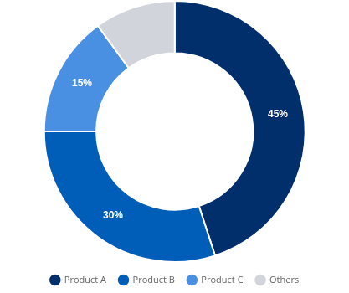




Beyond Lines & Bars
Specialized Visuals: The Right Tool for the Job
"Pie charts are for simple snapshots. Complex stories need flowcharts, Gantt charts, or heatmaps."
Snapshot View
Market Share (Part-to-Whole)
Flowcharts
Gantt Charts
Use for: Processes, decision points, and clarifying ownership steps.
Use for: Project timelines, overlapping schedules, and progress tracking.
Heatmaps
Icons
Use for: Showing intensity, density, or performance hotspots in large datasets.
Use for: Quick visual cues, navigation, and breaking up text-heavy slides.
Best Practice: Limit to 5 slices or fewer. Order largest to smallest starting at 12 o'clock.
MODULE 3: VISUAL MESSAGES + CLEAR WRITING
Specialized Visual Types

Slide 15



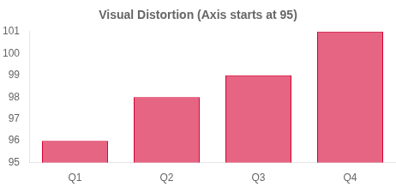
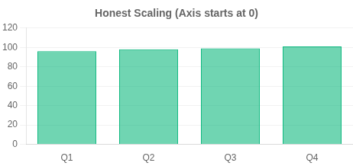




Ethical Visual Communication
Case Study: The Misleading Chart Problem
"Visual manipulation damages credibility instantly."
DECEPTIVE
ETHICAL
The "Sales Doubled" Illusion
The Honest Representation
A y-axis starting at 95 makes a small 5% increase (96 to 101) look like a massive 100% jump.
A y-axis starting at 0 shows the true scale of growth. The visual matches reality: a steady, modest increase.
Impact:
The Ethical Fix:
The audience feels manipulated when they realize the truth. The presenter is labeled as "untrustworthy" or "hiding something."
Use honest scales (Start Y-axis at 0 for bar charts).
Label clearly without "visual tricks."
State the takeaway in text: "Sales grew 5% this quarter."
MODULE 3: VISUAL MESSAGES + CLEAR WRITING
Ethical Data Visualization Principles

Slide 16













Ethics & Integrity
Ethical Visual Communication
"Your credibility depends on truthful representation of data."
DO
Best Practices
DON'T
Avoid These Pitfalls
Use Honest Scales
Truncate Axes to Exaggerate
Start bar chart axes at zero. Maintain consistent intervals to show true proportion and scale.
Avoid cutting off the bottom of bar charts to make small differences look massive (the "lie factor").
Label Clearly & Cite Sources
Use Distracting 3D Effects
Define all axes, units, and data points. Always credit where the data came from to build trust.
3D angles distort perspective and make values hard to read. Stick to flat, clean 2D designs.
Note Missing Data or Context
Cherry-Pick Data
Be transparent about outliers, excluded data points, or unusual time periods (e.g., "Q4 data incomplete").
Don't select only the timeframes or data points that support your argument while hiding negative trends.
State the Takeaway
Over-Segment Pie Charts
Use a clear title or caption that summarizes the main finding in words to prevent misinterpretation.
Avoid pie charts with too many slices (5+). They become unreadable clutter. Use a bar chart instead.
MODULE 3: VISUAL MESSAGES + CLEAR WRITING
Ethical Standards for Business Charts

Slide 17

Module 3 • Section 2
06
In This Chapter
Crafting Effective
Sentences and Paragraphs
1
Clear Writing Principles
Reader support vs. sophistication
2
Sentence Clarity Tools
Active voice & cutting fillers
3
Paragraph Structure
The Point-Support-Action framework
Clear writing is reader support, not "being fancy." Learn how to reduce cognitive load, structure sentences for impact, and build paragraphs that guide your reader's decision-making.
4
Practical Application
Workbook activities & examples

Slide 18






Chapter 6: Clear Writing
Clear Writing =
Reader Support
Use Short Sentences
Keep ideas digestible. One main idea per sentence prevents confusion and fatigue.
Choose Concrete Words
Replace vague concepts with specific details. "Improve performance" → "Increase sales by 10%".
In business, clarity isn't about being simple—it's about being efficient. Your goal is to reduce the cognitive load for your reader.
Follow Logical Order
Structure information the way the brain processes it: Context → Action → Details.
Assign Clear Responsibility
Use active voice to clarify who does what. "The form was sent" (Vague) → "John sent the form" (Clear).
"Clarity beats sophistication in business contexts."
MODULE 3: VISUAL MESSAGES + CLEAR WRITING

Slide 19





Sentence Clarity Case Study
Case Study: The One Sentence That Broke the Process
"Ambiguity is the enemy of action."
UNCLEAR
CLEAR
The Ambiguous Instruction
The Actionable Instruction
Passive voice and vague nouns leave critical questions unanswered.
Specific actors, actions, destinations, and deadlines remove all doubt.
From: Student Worker
From: Student Worker (Revised)
"The forms should be after they are ."
"After the forms, by ."
sent to administration
you complete
email them to Student Affairs
completed
Friday at 3 PM
The Breakdown:
The Clarity Fix:
Who sends them?
Actor Defined
Me? You? The system?
"You" (the reader)
Which "Administration"?
Destination Specified
HR? Finance? Student Affairs?
"Student Affairs" (not generic admin)
How & When?
Method & Time
Email? Hard copy? Deadline?
"Email" + "Friday at 3 PM"
MODULE 3: VISUAL MESSAGES + CLEAR WRITING
Clear Writing Principles

Slide 20





Writing for Clarity
Sentence Tool A: Put the Main Point Early
The Rule: Readers pay attention to the first 5-7 words. If you bury the main action after a long introduction, you increase cognitive load and risk confusion.
Before: Burying the Lead
High Cognitive Load
After: Leading with Purpose
Instant Clarity
draft_v1.txt
final_version.txt
"Due to several scheduling conflicts regarding the conference room availability and the fact that the projector is currently broken,"
the meeting is moved to Room B.
because the conference room is double-booked and the projector is broken.
"The meeting is moved to Room B"
The Problem: Delaying the Action
The Fix: Front-Loading
The reader has to wade through 22 words of context before finding the verb ("is moved"). They might stop reading before they get there.
The main action is in the first 7 words. Context follows. The reader knows what to do immediately, even if they stop skimming.
MODULE 3: VISUAL MESSAGES + CLEAR WRITING
Principle: Treat the reader's attention as a scarce resource.

Slide 21













Sentence Clarity Tool B
Prefer Active Voice for Responsibility
The Problem: Passive voice often hides the actor ("mistakes were made").
The Fix: Active voice clarifies who did what ("I made a mistake").
Passive Voice
Active Voice
Clear & Responsible
Weak & Vague
?
We
we
" didn't submit the report, so can't finalize the proposal."
"The report was not submitted on time."
Action (was not submitted)
Actor Missing?
Actor (We)
Action (didn't submit)
Consequence
Why it fails
Why it works
Who is responsible? The sentence hides the actor. It sounds bureaucratic and avoids accountability. The reader doesn't know who to follow up with.
Clear responsibility ("We"). It states the action directly and links it to the consequence ("can't finalize"). This builds trust through transparency.
Module 3: Visual Messages + Clear Writing
Tip
Name the actor + action + consequence
21

Slide 22




Sentence Clarity Tool C
Cut Filler Phrases
Principle: Remove empty words that delay the point. Start sentences with real meaning, not "throat-clearing" phrases.
Before: Wordy & Slow
Cognitive Drag
After: Direct & Professional
Instant Meaning
Common "Throat-Clearing"
Tighter Alternatives
Example 1
Fix 1
"I am writing to inform you that the meeting has been moved."
"The meeting has been moved."
Just say it directly
7 words of filler before content
Fix 2
Example 2
"Currently, we do not have the budget."
"At this point in time, we do not have the budget."
Replaced 5 words with 1
Cliché phrase for "now"
Fix 3
Example 3
"Because the data is incomplete..."
"Due to the fact that the data is incomplete..."
Simple connector word
Wordy substitute for "because"
MODULE 3: VISUAL MESSAGES + CLEAR WRITING
Concise writing shows respect for the reader's time

Slide 23








Advanced Clarity Tools
More Sentence
Techniques
Eliminate Redundancy
Remove words that repeat meaning.
Ex: "Collaborate together" → "Collaborate"
Use Specific Words
Replace vague terms with concrete details to create a vivid mental picture.
Refine your professional writing style with these five additional techniques for maximum impact and readability.
Avoid Jargon
Use plain language unless you are certain your audience knows the technical terms.
Prefer Familiar Verbs
Choose simple, direct verbs to make your writing accessible.
Ex: "Use" instead of "Utilize"
Vary Sentence Length
Mix short and long sentences to create rhythm and maintain reader interest.
MODULE 3: VISUAL MESSAGES + CLEAR WRITING

Slide 24



Effective Writing
Paragraph Structure:
Point-Support-Action
P
Point (Topic Sentence)
State the main idea or takeaway immediately.
"We recommend switching to Vendor B for cost efficiency."
S
Support (Evidence)
The PSA framework ensures every paragraph has a clear purpose and drives the reader forward.
Provide 2-3 sentences of key details, data, or context.
"Vendor B offers a 15% discount on bulk orders and guarantees 24-hour delivery, unlike our current provider."
Why it works:
Reduces cognitive load
Action (Next Step)
A
Prevents "buried leads"
Tell the reader exactly what happens next or what they need to decide.
Clarifies next steps
"Please approve this change by Friday so we can lock in the Q3 rates."
MODULE 3: VISUAL MESSAGES + CLEAR WRITING

Slide 25








Paragraph Structure Comparison
Strong vs. Weak Paragraphs
Principle: Effective paragraphs guide the reader with structure. Weak paragraphs bury the main point and lack a clear call to action.
Weak: Buried Point
Strong: PSA Structure
We looked at several vendors for the new project, and Vendor A had good service but high prices. Vendor C was cheap but had bad reviews. Vendor B seems like a good middle ground because their prices are reasonable and they have good reliability scores, although we need to check their references. Anyway, we should probably go with them if everyone agrees, but we need to decide soon because their offer expires on Friday.
We recommend selecting Vendor B for the project based on cost and reliability.
POINT
SUPPORT
Unlike Vendor A (too expensive) and Vendor C (poor reviews), Vendor B offers the best balance of reasonable pricing and high reliability scores confirmed by references.
Please approve this selection by Friday to secure their current pricing offer.
ACTION
Analysis: Why it fails
Main point is buried in the middle ("Vendor B seems like...")
Analysis: Why it works
Wandering structure mixes facts and opinions
Weak action ("probably go with them")
Point first: Recommendation is immediate and clear
Key deadline is hidden at the very end
Structured support: Evidence is grouped logically
Clear action: "Approve by Friday" tells reader exactly what to do
MODULE 3: VISUAL MESSAGES + CLEAR WRITING
Structure dictates readability

Slide 26











Practice & Application
Workbook Activities
"Apply the principles of clarity and visual design."
1
2
3
De-cluttering
Visual Formatting
Ethics Redesign
Shorten this sentence to fewer than 10 words without losing meaning.
Sketch how you would format a grocery list of 15 items to make it skimmable.
Redraw a misleading chart (y-axis starting at 95) with an honest axis.
"At this point in time, we are of the opinion that the meeting should be cancelled due to the fact that the data is not ready." (26 words)
Hint: Use categories (Produce, Dairy, Dry Goods) and bullets.
Task: Start axis at 0 and add a one-sentence takeaway.
SKETCH AREA
100
Write your improved version here:
0
Draw bars here
MODULE 3: VISUAL MESSAGES + CLEAR WRITING
Hands-on Exercises

Slide 27











Module Wrap-Up
Summary & Key Takeaways
"Clarity is the foundation of professional credibility."
Design for Scanning
Match Chart to Question
Next Steps
Readers skim before they read. Use headings, bullets, and bold text to guide the eye and highlight key information.
Choose the right visual tool: Lines for trends, Bars for comparison, Tables for exact values. Always use honest scales.
Complete Workbook Activities
Review your recent emails
Practice ethical charting
Write Clear Sentences
Build PSA Paragraphs
Cut filler words. Put the main point first. Use active voice to clarify responsibility (Who does What).
Structure paragraphs logically: Point (Topic), Support (Evidence), Action (Next steps/Conclusion).
"The goal of business communication isn't just to be understood—it's to make it impossible to be misunderstood."
MODULE 3: VISUAL MESSAGES + CLEAR WRITING
Module Complete

