Slide 1

Module 1
Foundations of
Business
Communication
Build a reader-centered mindset:
Help people act, decide, and feel confident.
Why it Matters
•
Problem-Solving
•
Etiquette & Tone

Slide 2






Module 1 Scope
Module Overview & Learning Objectives
By the end of this module, you will be able to:
Typical Work in Module 1
Explain the Business Impact
Understand how communication drives credibility, efficiency, and measurable business results.
Tone Makeovers
Transforming rude, unclear, or robotic messages into professional, reader-centered communication.
Adapt Your Message
Before & After
Tailor content effectively to specific audiences, purposes, and workplace contexts.
Master Professional Tone
Scenario Responses
Apply the "you-viewpoint" and courteous language to build reader-centered messages.
Analyzing short workplace scenarios to choose the most effective message strategy.
Identify & Fix Mistakes
Critical Thinking
Spot common tone errors and revise them to be professional and clear.

Slide 3












The Operating System of Work
Why Communication Matters
When It's Strong
When It's Weak
Speed & Efficiency
Costly Delays
Clear messages reduce rework and prevent confusion, allowing work to move faster.
Vague messages lead to duplicated effort, avoidable errors, and missed deadlines.
Strategic Alignment
Misalignment
Everyone understands priorities, goals, and decision rights.
Teams optimize for different goals, pulling in opposing directions.
High Trust
Consistent, respectful interactions build a foundation for collaboration.
Low Trust
Leads to defensive documentation, excessive approvals, and slowed decisions.

Slide 4









Business Value
7 Reasons Communication Matters
Protects Time & Money
Strategic Outcomes
Clear messages reduce rework, prevent costly errors, and speed up decision-making.
Drives Loyalty
Aligns Goals & Priorities
Customers evaluate the experience, not just the product.
Helps teams understand the mission so they can make autonomous decisions.
Reduces Conflict
Builds Trust
Keeps tension productive by focusing on solutions, not blame.
Reliable, respectful communication is a business asset that speeds up collaboration.
Supports Growth
Shapes Company Culture
Strong communicators get more opportunities and responsibility.
Everyday tone and responsiveness teach employees what is normal and safe.

Slide 5














Interpersonal Skills & Strategy
Solving Problems with Communication
Core Skills
Keep It Productive
Ask Clear Questions
Define the Real Issue
Inquire without sounding accusatory to uncover facts.
Clarify goals, what "done" looks like, and existing constraints.
Explain Without Blame
Lower Defensiveness
Focus on the situation and impact, not personal faults.
Use "I-statements" and focus on observable facts to reduce tension.
Listen Actively
Confirm Understanding
Pay attention to both the facts presented and the emotions behind them.
Paraphrase what you've heard to ensure alignment before moving on.
Manage Tone & Timing
Negotiate Tradeoffs
Keep interactions calm and choose the right moment to address issues.
Collaboratively balance scope, time, and quality requirements.
Follow Up
Drive Clarity
Document decisions, assign owners, and set clear deadlines.
Convert confusion into clear, actionable next steps.

Slide 6

























Process Methodology
Practical Playbook: Confusion Clarity Action
1
Define the Problem
2
Ask Questions
3
Manage Tone
Define the problem precisely before proposing solutions. Ensure everyone is solving the same issue.
Ask questions before making assumptions. Clarify facts to avoid working on incorrect premises.
Stay calm, respectful, and solution-focused. Keep the conversation productive, not emotional.
Target: Precision
Target: Facts
Target: Respect
4
Listen Actively
5
Negotiate Tradeoffs
6
Close the Loop
Use follow-ups and paraphrase to confirm understanding. Surface hidden constraints.
Agree on the best path forward. Balance scope, time, and quality to find workable solutions.
Document decisions, assign owners, set deadlines, and schedule the next check-in.
Target: Understanding
Target: Agreement
Target: Action

Slide 7
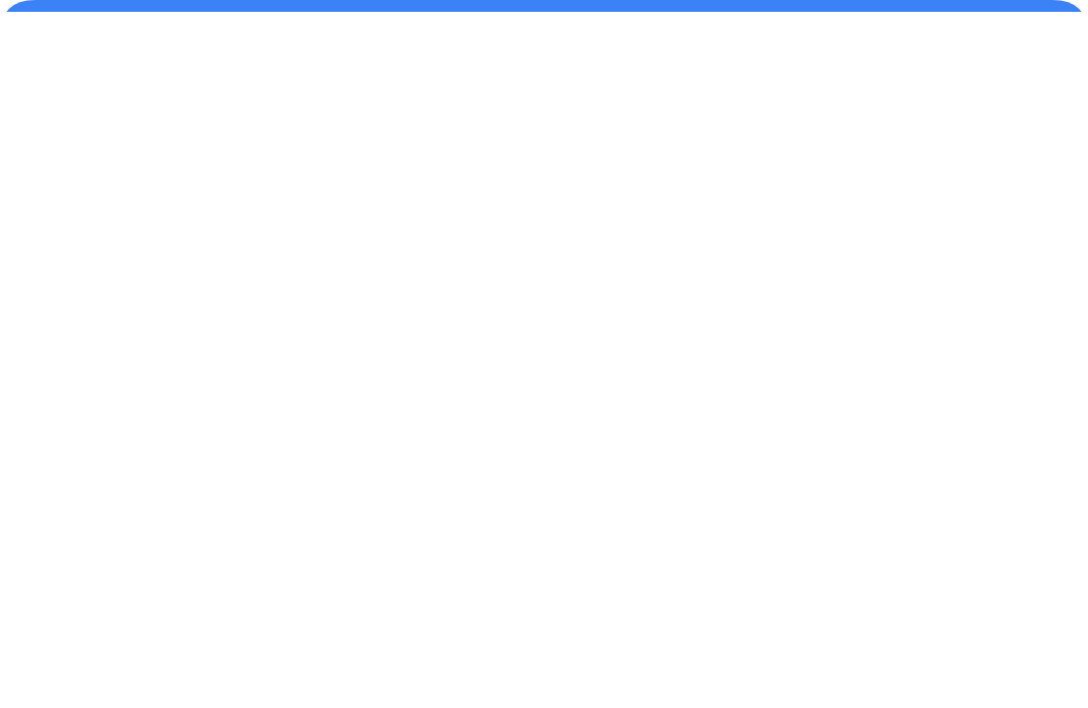
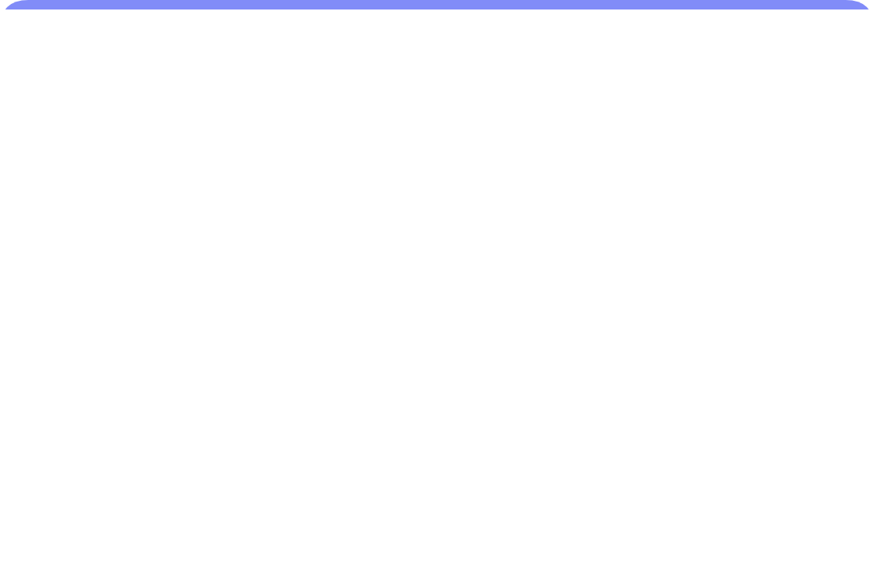
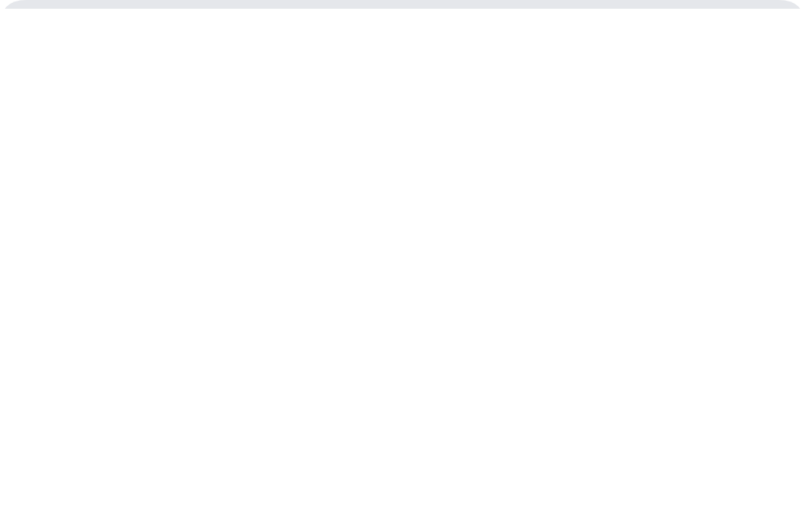





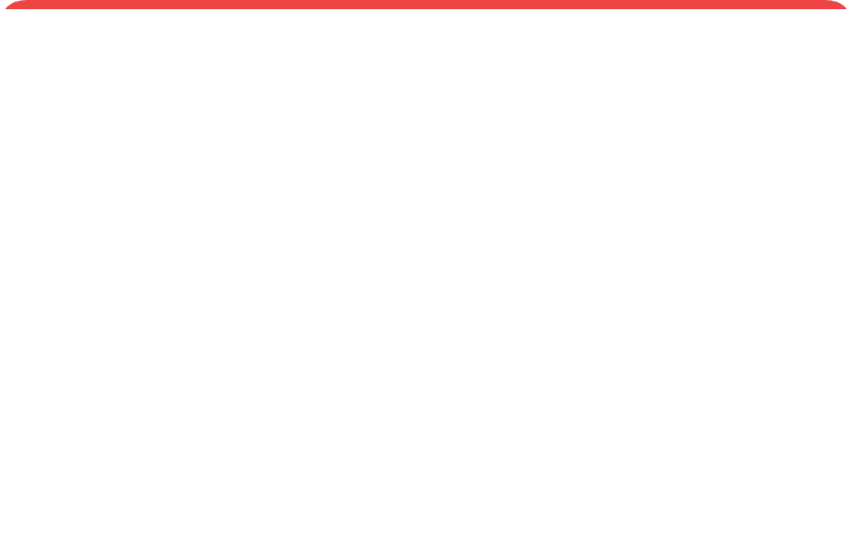






Case Study: BrightLine Outfitters
The Launch That Almost Went Sideways
Anatomy of a communication breakdown and recovery
1
2
3
The Setup
The Ambiguity
The Trouble
Mid-sized company launching a commuter backpack. High stakes: new supplier, new marketing, tight deadline.
PM sends: "Approved. We're good to go."
Team interprets it 5 different ways (Product? Packaging? Delivery?).
Supplier missing artwork. Marketing scheduling posts for wrong claims. Sales promising "early Friday" delivery without proof.
Status: Confident
Status: Confused
Status: Misaligned
4
5
6
The Tension
The Intervention
The Result
"Why is Ops messing with Marketing?"
Defensive replies. The logistics issue becomes a people issue.
Maya calls huddle. Clarifies facts ("promise gap"). Invites constraints without blame. Negotiates tradeoffs.
Launch shipped Friday. Retailer aligned. Marketing claims fixed. Relationships intact.
Status: Conflict
Status: Problem Solving
Status: Success

Slide 8












Building Your Reputation
Professionalism & Business Etiquette
Why It Matters
Core Habits & Essentials
Credibility & Trust
Be Clear & Complete
Clear, organized messages make you sound prepared and capable.
Avoid bloat. State exactly what is needed and by when.
Protects Relationships
Respectful Tone
Respectful tone prevents misunderstandings from becoming conflict.
Essential especially under stress, deadlines, or mistakes.
Brand Representation
Choose the Right Channel
Your messages become the company's image to customers.
Use voice/video for emotional, confusing, or complex topics.
Career Growth
Be Timely
Strong communicators are trusted with higher-stakes opportunities.
Silence creates confusion; acknowledge receipt even if delayed.

Slide 9











Module 1 Tools
Conversational Style & Tone Tools
Essential Tools for Professional Tone
Applying the Tools
Conversational Style
Write like a human, not a robot. Be warm and clear while maintaining professional boundaries (avoiding slang).
Scenario: Wrong File Uploaded
The You-Viewpoint
Neutral / Blunt
"You uploaded the draft file, not the final version."
Focus strictly on the reader's needs, benefits, and perspective. Answer their silent question: "Why does this matter to me?"
Courtesy & Respect
Maintain emotional control to protect relationships, especially when delivering bad news or correcting errors.
Positive + You-Viewpoint
"Once you upload the final version, you'll be all set. If you can send it by 5 PM, I'll review it tonight."
Positive Wording
Frame messages around what can be done rather than what can't. Create forward movement instead of defensiveness.

Slide 10


















Communication Framework
Repeatable Method: Design Effective Messages
1
Define the Goal
2
Identify Stakeholders
3
Choose Outcome
Summarize the purpose in one clear sentence. Know exactly what you are asking for before you start writing.
Consider primary readers and "hidden audiences" (managers, HR, forwards). Write for the neutral third party.
Determine the specific result needed: a decision, an action, or increased confidence. Align the ask to this outcome.
Focus: Clarity
Focus: Reach
Focus: Result
4
Design for Reader
5
Draft with Structure
6
Choose Channel
Adopt the you-viewpoint. Consider their constraints, benefits, and perspective to increase cooperation.
Organize logically: Purpose, Context, Request, Timeline, and Next Steps. Don't bury the lead.
Select based on need: Chat (quick), Email (record), Voice/Video (tone/emotion), or Meeting (alignment).
Focus: Empathy
Focus: Logic
Focus: Medium

